Slide 1

SI 206 Final Project
--by Yang Meng
Ted Yuan
Haochen Yu

Slide 2
Original Goals
· To collect the information (artist, name, category, price) of a song and
to compare how many songs that each music platform have
· Use three APIs/websites (ITunes api and YouTube Music api)
· Create three visualizations

Slide 3
Goals achieved
Api used: Itunes, LastFM
Website used: Billboard Top 100 hottest music
We want to know how to price different of each song
Create three graphs to show how prices affect popularity

Slide 4
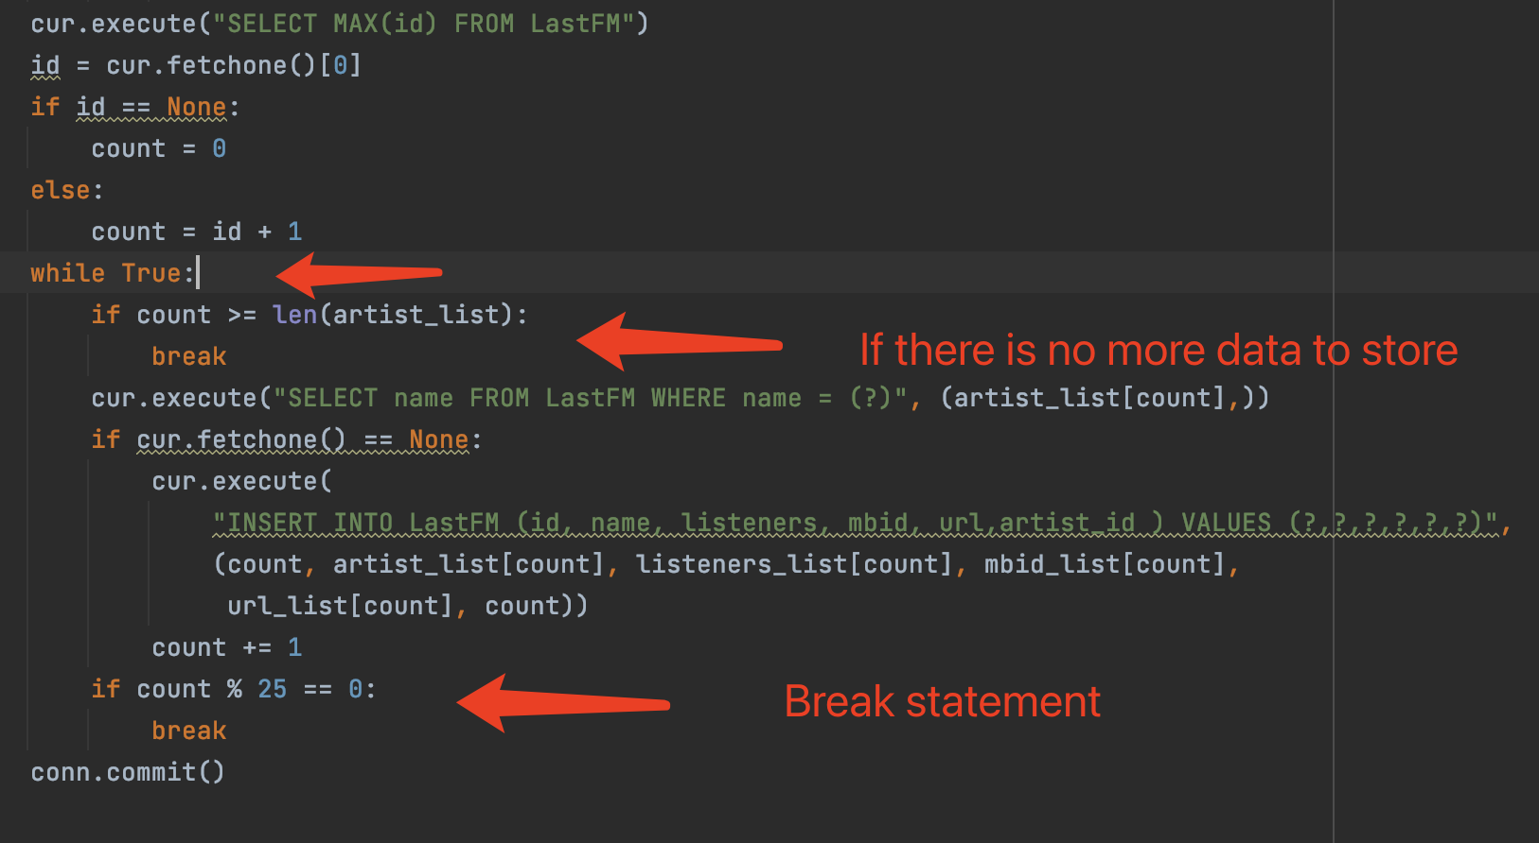
How we limit storing data?
We start by using a while loop, then use a variable called count. Every time we store data into the database. We increment the count by one. When count hits 25, we break the loop which means stop storing the data.

Slide 5
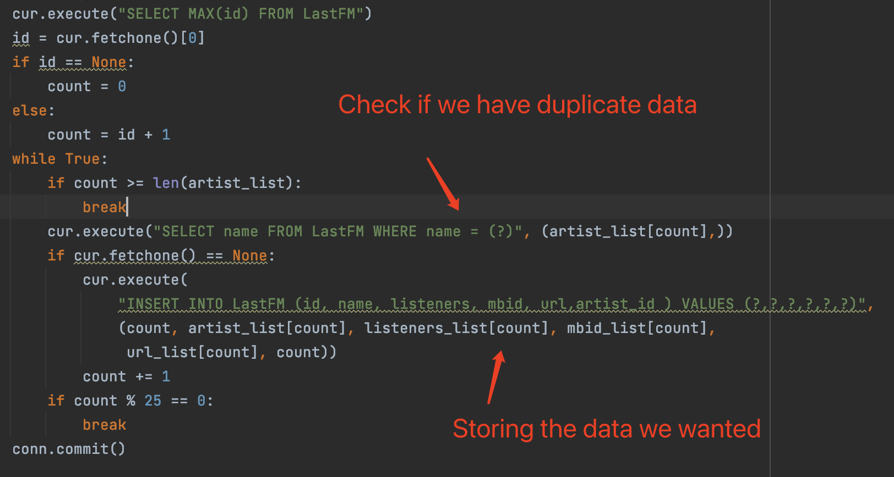
How we make sure there is not duplicate data?
We use a command “"SELECT staff FROM table WHERE staff = (?)", (data,)”. If we get the return data as “None”, we know it is not in the database which means we can store those data. If it returns anything other than ”None”, we know we already had these data so we do nothing.

Slide 6
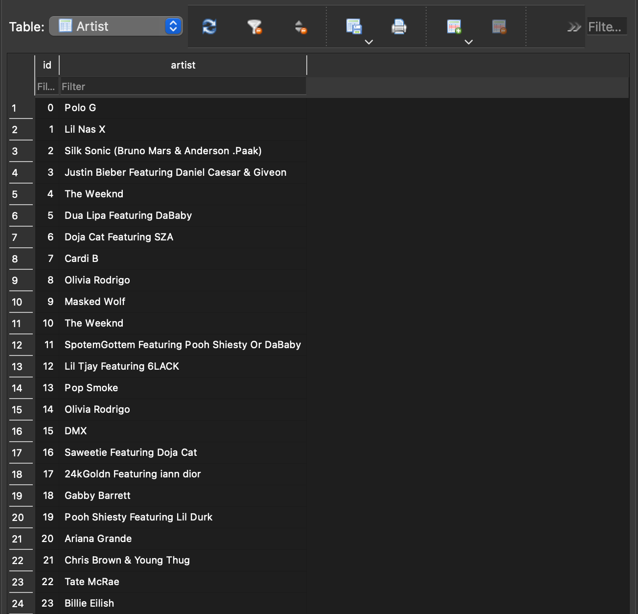
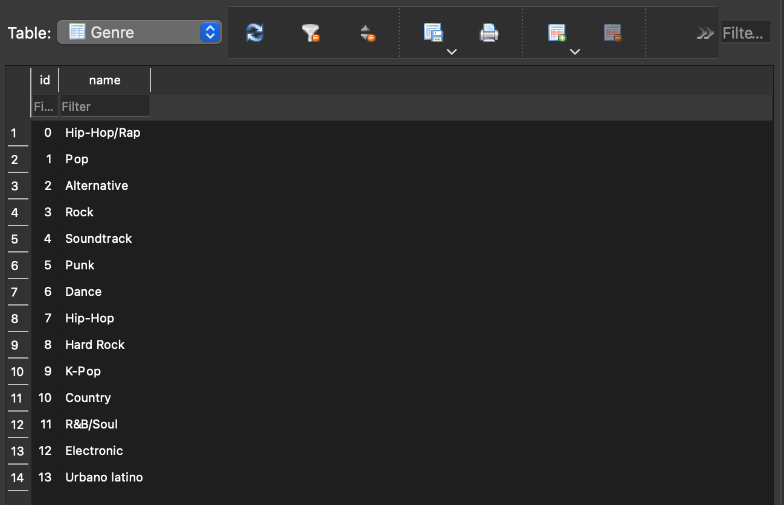
Tables for Artist & Genre, created from dataBase.py

Slide 7
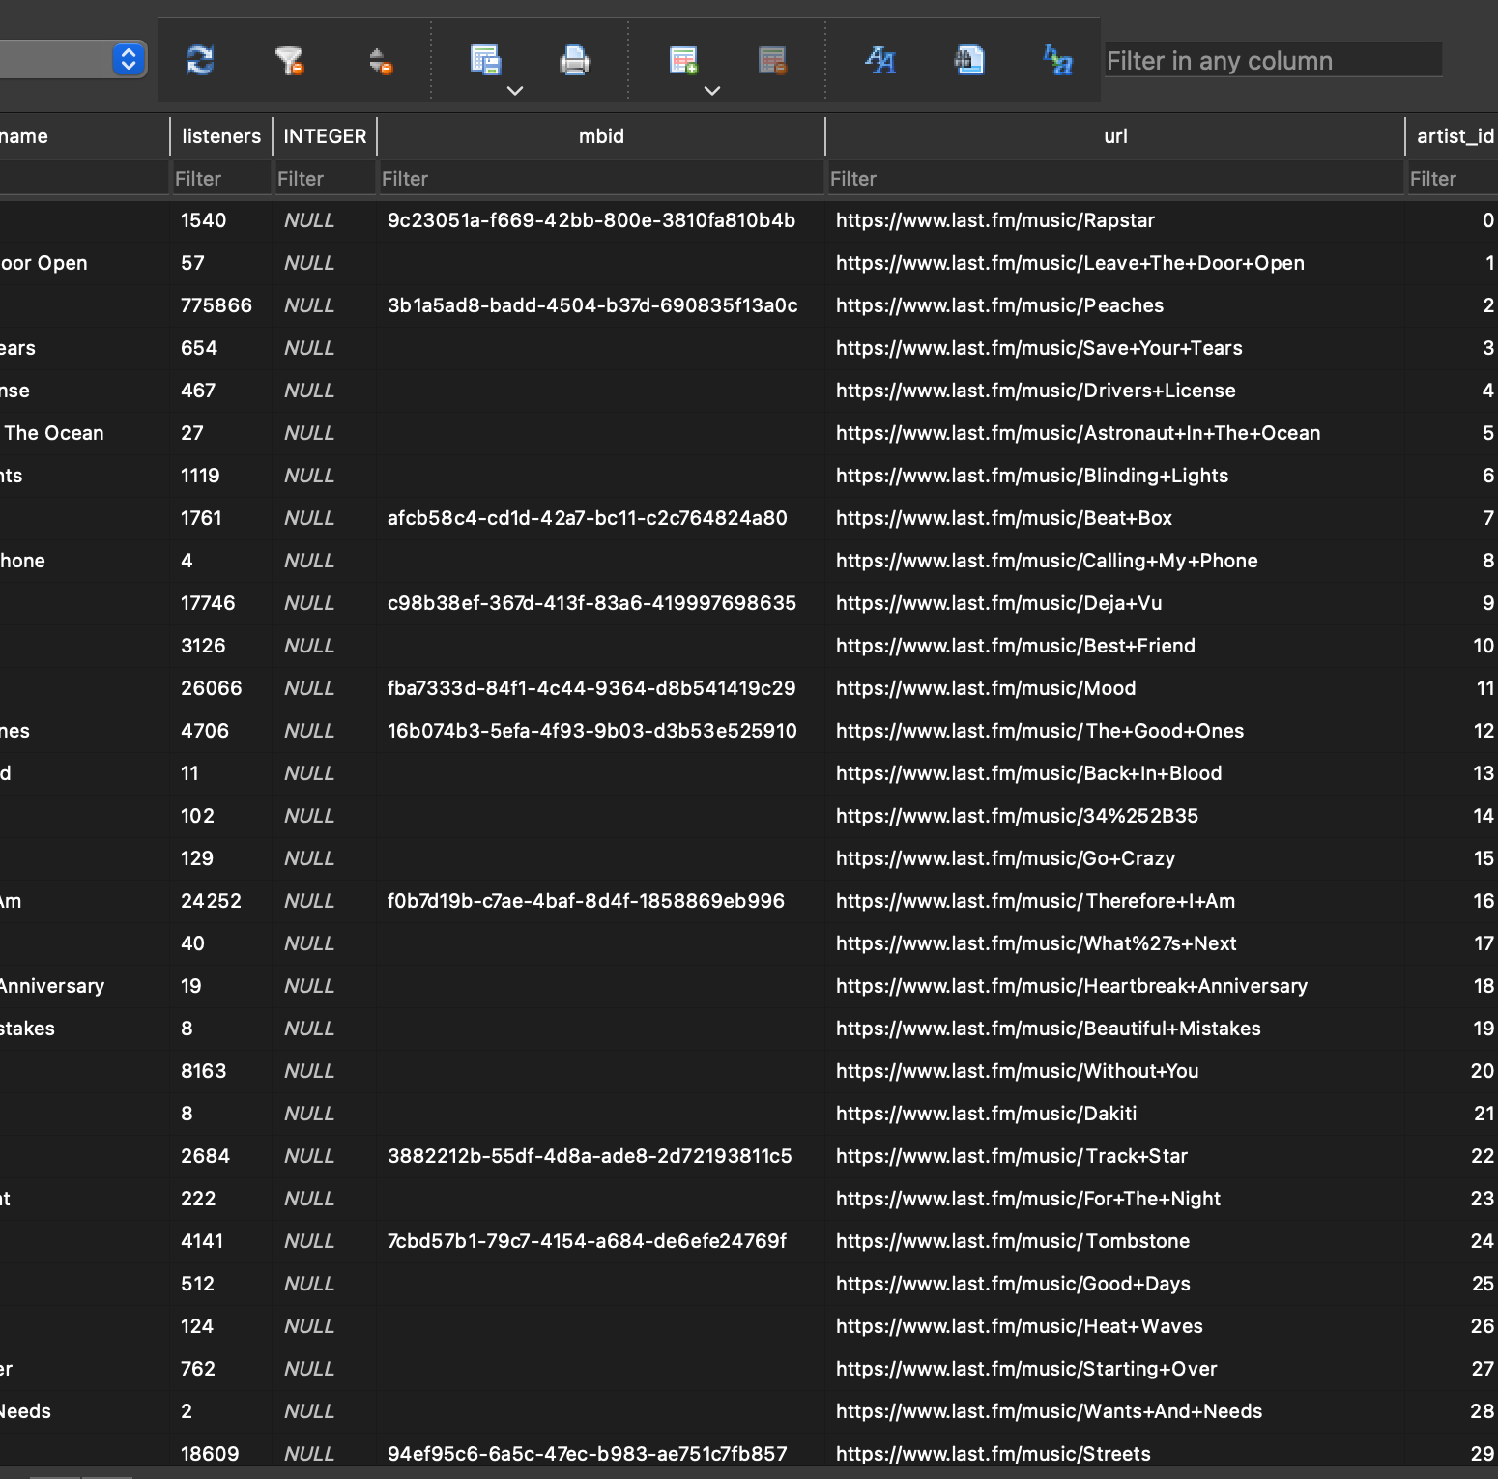
Table for LastFM, created from dataBase.py

Slide 8
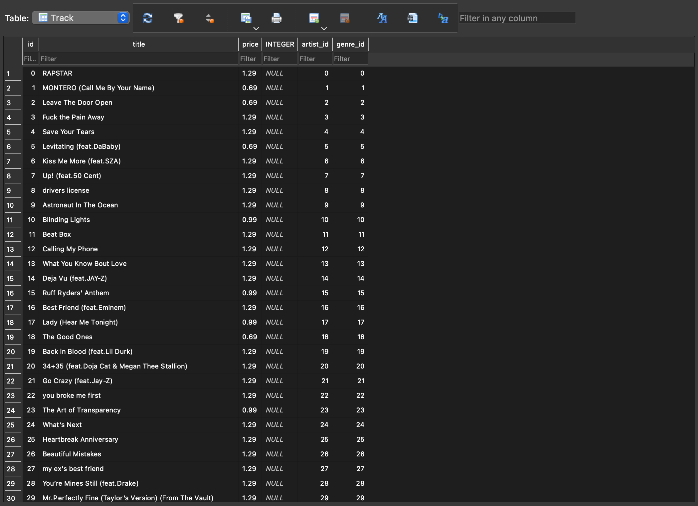
Table for Track, created from dataBase.py

Slide 9
Problems
We met a problem about collecting Data from Youtube api. So we decide to switch to another api
We also met problems with limiting import to the database. The office hour helped us a lot
When drawing the graph, we failed to modify the font size

Slide 10
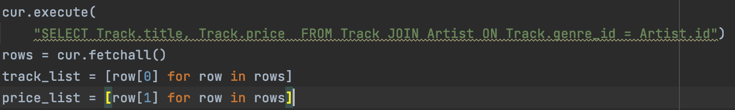
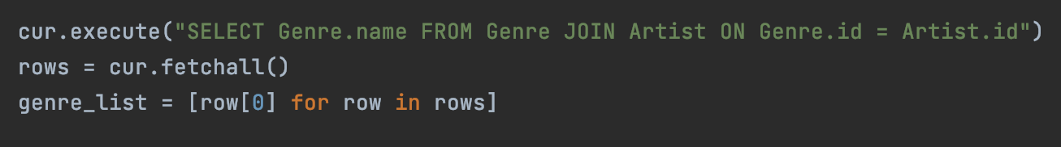
Calculations
We calculated the minimum price, average price, and the maximum price of a track.
We also calculated the price distribution based on the data
Then we made diagrams to better demonstrate the result.
In order to calculate those data, we used “JOIN” keywords to get the data we wanted.

Slide 11
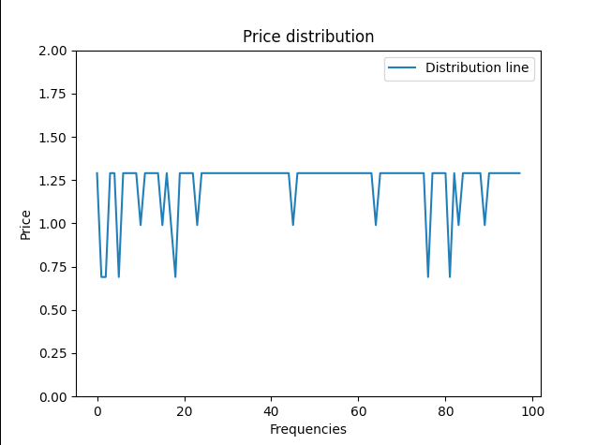
Visualizations

Slide 12
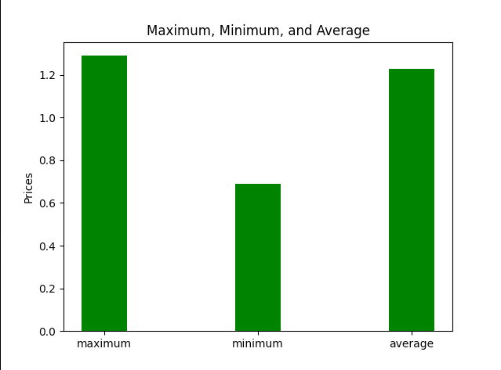
Distribution graph

Slide 13
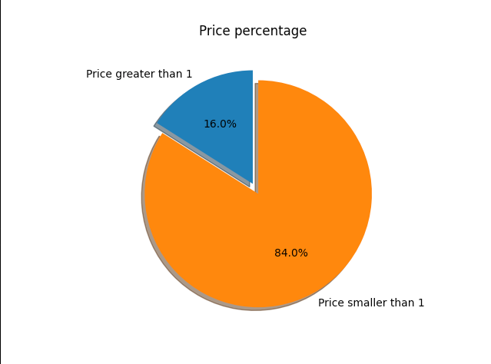
Percentage

Slide 14
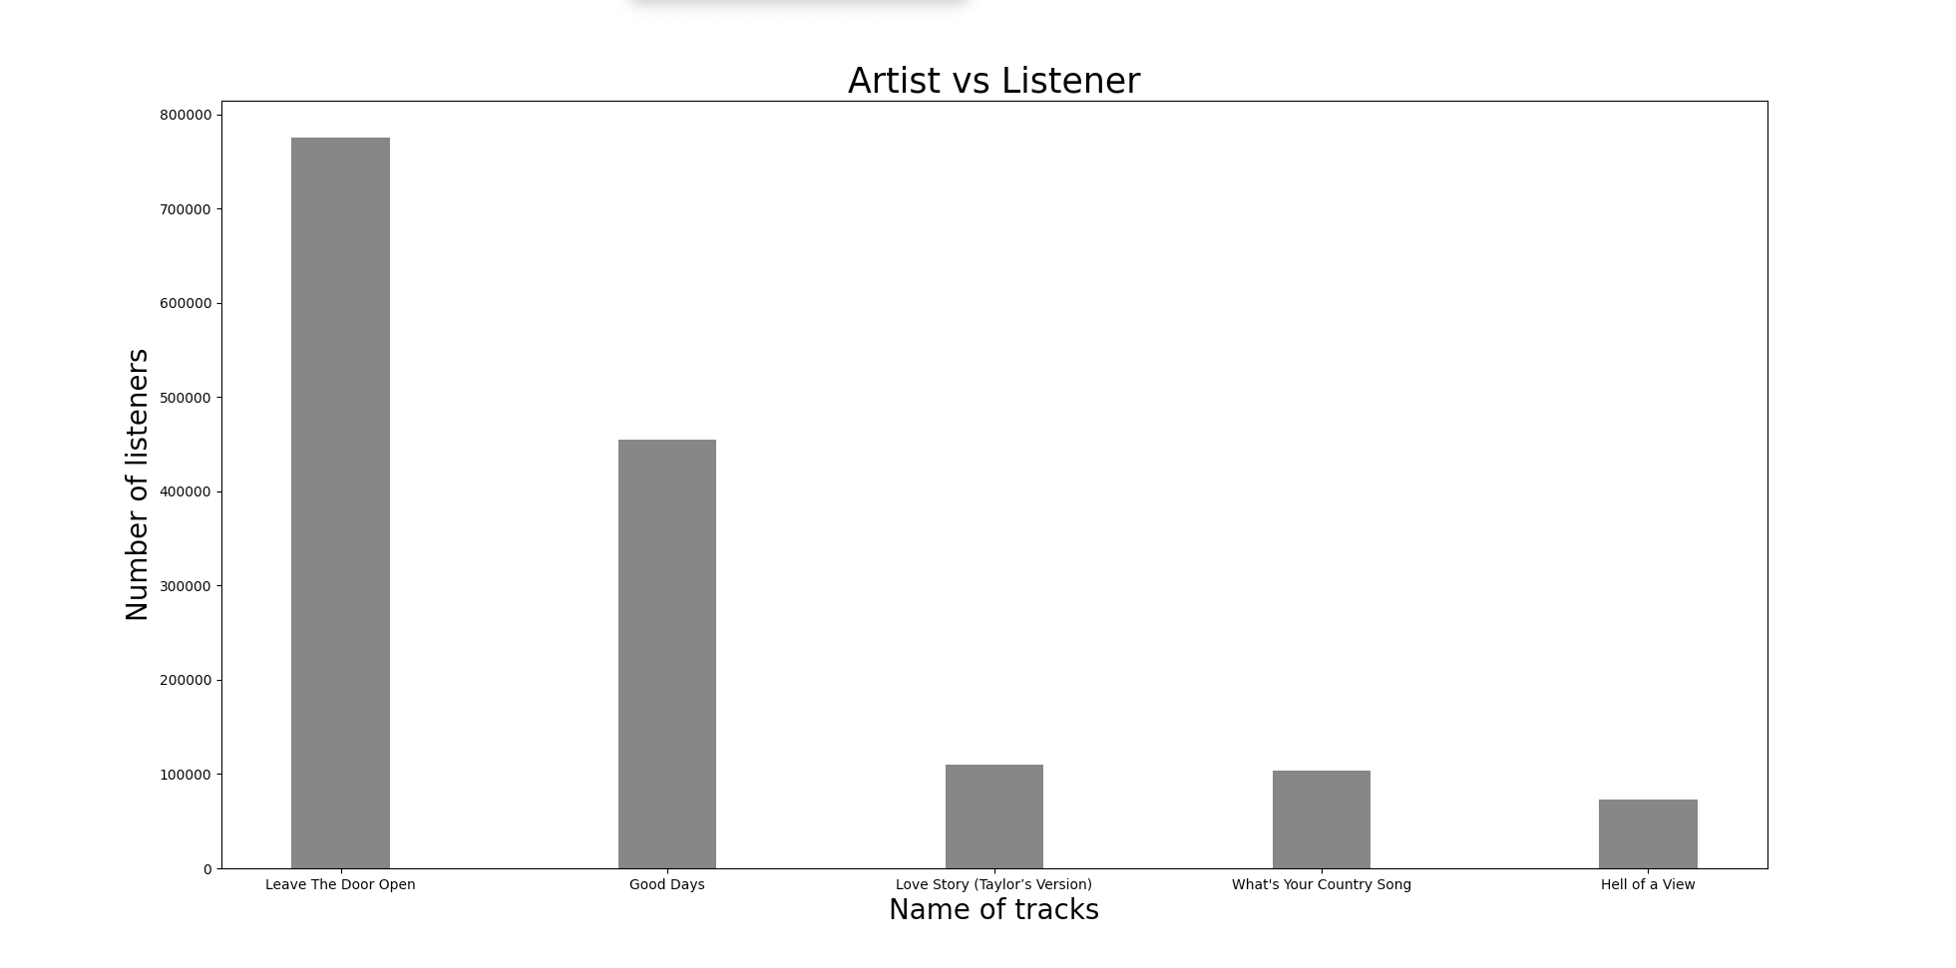
Tracks graph

Slide 15
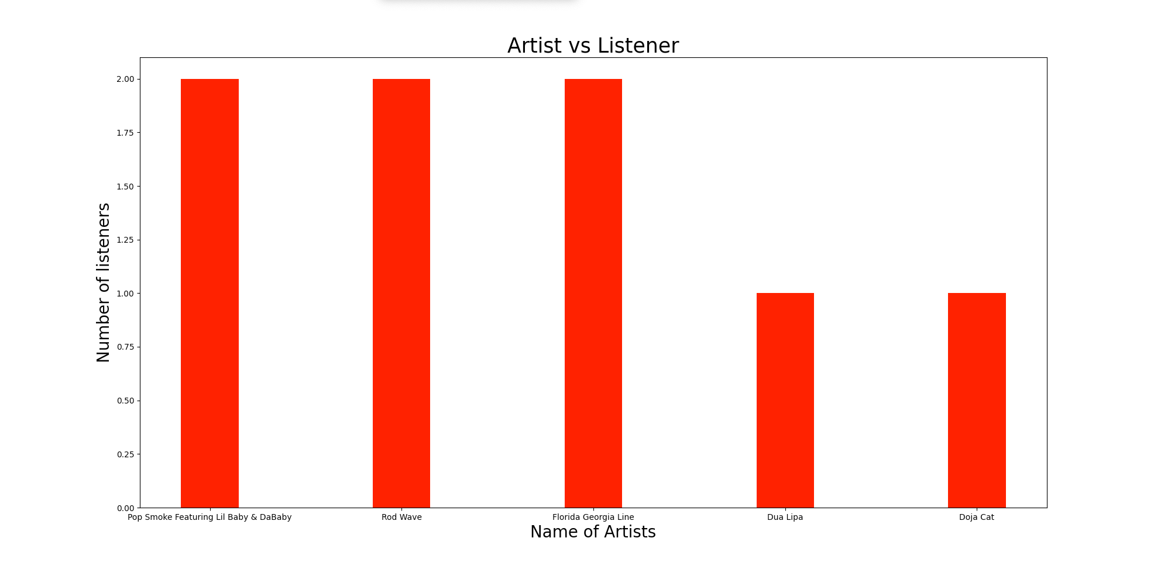
Artist vs Listener

Slide 16
Code Documentation
top_100_songs_from_billboard():
“No inputs. Uses BeautifulSoup to read the top 100 songs. Returns a dictionary in the format (song’s name: artist) ”
set_up_data_base(file_name):
“Takes the name of a database, a string, as an input. Returns the cursor and connection to the database”
create_tables(cur, conn):
”Takes the database cursor and connection as inputs. Returns nothing. Create four tables: Artist, Genre, Track, LastFM”
add_data_to_artist(cur, conn):
”Takes the database cursor and connection as inputs. Add artists info into the database”
add_data_to_genre_track(cur, conn):
”Takes the database cursor and connection as inputs. Add genre info into the database”
add_data_to_LastFM(cur, conn):
”Takes the database cursor and connection as inputs. Add LastFM info into the database”

Slide 17

Thank You!

